Slide 1
Post-Merger/-Acquisition Integration
Session 1
Thursday, Feb. 26, 2015, 9:15 am

Slide 2
Ulrich Bormann, Evonik Industries
Gunda Niehaus, Procter & Gamble
Gerlind Wisskirchen, CMS Hasche Sigle

Slide 3
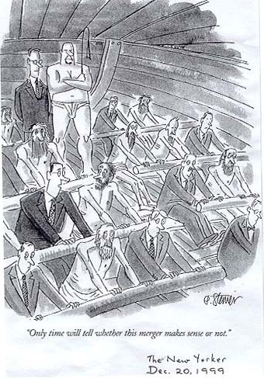
The challenge

Slide 4
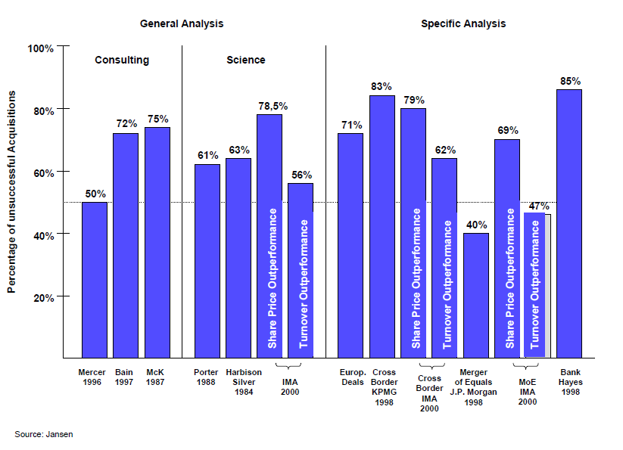
Failure rates of mergers: overview empirical studies

Slide 5
M&A's make significant contributions to relative growth – but most acquisitions tend to destroy relative value
… but most acquisitions fail to create value

Slide 6
Problems and reasons for failure
Study by A.T.Kearney of 115 enterprises: Results
Focusing on new company structures before transaction instead of focusing on new business procedures | only 28% follow clear strategies
Competition for leading positions | only 39% appointed new management in good time, e.g. CEO Glaxo Wellcome and Smithkline Beecham
Conflicting aims between newly merged company divisions | 76% focus on the implementation of cost synergies only
Disregarding the interests of staff | 61% focus exclusively on redundancies for fast success
Ignoring Interaction in the integration process | only 32% pursued active risk management, e.g. HypoVereinsbank value adjustment 3.5 bill.
Prolonged integration period | 86% did not sufficientliy communicate their M&A plans, e.g. BMW and Rover
Lack of detailed integration concepts | Buyer's culture was mainly foisted upon acquired firms

Slide 7
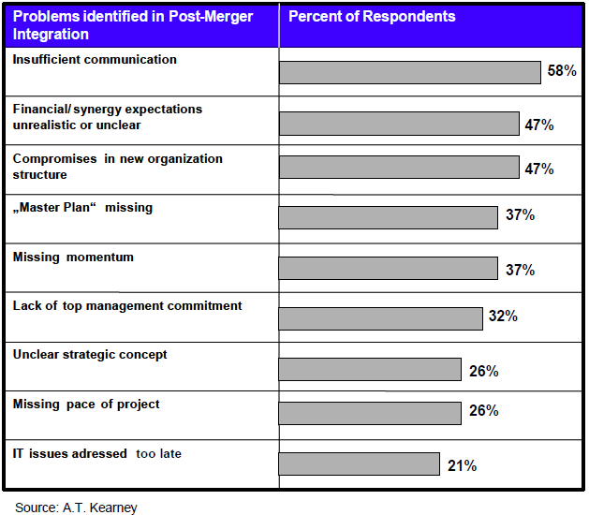
Problems and reasons for failure

Slide 8
Five rules for a successful PMI
Focus on value adding potentials
Organize quickly and execute rapidly
Consequent and rigorous management of the organizational integration:
Integration management and controlling
Cultural integration:
Develop a common vision and culture
Leadership
People loyalty program
To secure key customers is a must
Complete and open communication with all persons involved

Slide 9
Success factors: Jansen/Körner 2001
 |  | Percentage of answers
1. | Rapid decisions about management structure | 57
2. | Internal and external communication strategy | 47
3. | Integration – and project team (part of PMI) | 27
4. | Harmonization of customer structure | 24
5. | Preparation of an integration plan (part of PMI) | 21
6 | Definition of core staff and harmonization of salaries and bonuses | 19
7. | New positioning of products and services | 19
8. | New segmentation and price policy | 18
9. | Consolidation of reporting procedures and tools | 14

Slide 10
Communication
Role of Communication
Communication plan
Who? What? When? To whom?
Conflicts of interests
Wall Street information requirements vs. Labor Relations
HQ's vs. local subs

Slide 11
Communication concept – from design to execution
Approach
Design: Integration Strategy fit and alignment with company cultures
Clarify: Communication Matrix and RACI
Execution: Deliver Communication Concept
Refine: Integrate Feedback from audience
1
3
5
7
Derive Communication Concept from Integration Strategy and objective of acquisition and Culture of NewCo
Develop Communication Matrix (who, what, how, when) and define responsibilties
Publish communication concept and deliver it
Adjust Communication Concept building on Employees and MT feedback
2
4
6
Align communication channels and materials with company cultures and current practices
Seek approval from MT for Communication Matrix and related RACI-chart
Ensure feedback routes from Day 1 onwards and check the pulse of employees

Slide 12
Change = overcome cultural differences
Create the climate
Lead the change
Operationalize the change
Role of change manager

Slide 13
ChangeWorks
TM
Start Of The Next Wave Of Change
CREATE THE
CLIMATE
FOR CHANGE
LEAD THE CHANGE
1
2
OPERATIONALIZE THE CHANGE
3
ENGAGE & ENVISION
ENERGIZE & ENABLE
EXECUTE
EXECUTE
Create and Communicate a Compelling Future State
Align Leaders and Key Stakeholders
Manage the Expectations of the Organization
Organize the Change Effort
Build Momentum with Early Successes
Visibly and Actively Engage Individuals
Design for Behavior Change
Hardwire Systems and Processes
Reward, Learn and Renew
Sustain and Improve Business Results
P&G CONFIDENTIAL RESTRICTED Internal Use Only
Unpublished Copyright 2008, P&G. All rights reserved.

Slide 14
Kübler-Ross change curve
Change? What Change?
Wow. Great.
This is bigger than I thought. What impact will that have?
Denial
Disbelief; looking for evidence that it isn´t true
Integration Changes integrated; a renewed individual
Decision
Learning how to work in the new situation; feeling more positive
This can
work and be good
Morale and competence
Frustration
Recognition that things are different; sometimes angry
Shock
Surprise or shock at the event
Experiment
Initial engagement with the new situation
I can see myself in
the future
Can I cope? Or at last – a change!
Depression
Low mood; lacking energy
Who am I? or This isn´t for me…
I am off!
Time

Slide 15
Employees will support change once they realize “what’s in it for them”
Explain the added value of the offer
What is changing and why?
What is the objective?
What will be the likely outcomes and possible scenarios?
What will change for us?
My company
My deal
What’s in it for me?
My work
Explain the situation
Will this change leave me better off or worse off?
How will my contribution be measured and rewarded?
Will my employment contract change? Is that beneficial for me?
Which competencies and expertise do I need?
Clarify the impact
Will I have a job? What will be my responsibilities?
How will my work assignments and my work environment change?
Will I report to someone else? Who will be responsible for what?
Will I have to follow new guidelines?
To achieve productive change, the organization has to understand what employees value, and employees have to value what is feasible.

Slide 16
Change – an integrated effort is important, a short-fall in one of the areas can cause a lot of damage.
+
Skills
+
Incentives
+
Resources
+
Communication
+
Action Plan
=
Great
Process
Vision
Communication
Org Design
Alignment of HR Policies & Practices
Job Design
Learnings
Alignment of HR Policies & Practice
Leadership
Tools
New Way of Working
New procecces
Capabilitiy Planing
Leadership
Tools
Change Strategy / Programm
Implementation Planning
+
Skills
+
Incentives
+
Resources
+
Communication
+
Action Plan
= Confusion
+
+
Incentives
+
Resources
+
Communication
+
Action Plan
Vision
= Anxiety
Vision
+
Skills
+
+
Resources
+
Communication
+
Action Plan
= Loss of Speed
& Quality
+
Skills
+
Incentives
+
+
Communication
+
Action Plan
Vision
= Frustration
+
+
+
+
+
= Fear, Doubt &
Uncertainty
Vision
Skills
Incentives
Resources
Action Plan
+
Skills
+
Incentives
+
Resources
+
Communication
+
= Random
Activity
Vision
© Ward Management 2009

Slide 17
Integration
IT
Comp & Ben issues
Payroll
Organization

Slide 18
Role of HR
Characteristics of a PMI HR Manager
Excellent communicator and counselor
Comprehensive experience in operative, international and strategic HR matters
Experienced in project management
Cross-functional background
Analytical skills and political acumen
Has a strong network of information and relationships throughout the company
Respected facilitator
Change management capabilities
Empathetic appearance; a person you trust
Needs to be involved in acquisition during DD phase.
Dependant on scope: Devotes 30 – 100% of capacity and attention to the PMI HR duties

Slide 19
The Post Merger Integration Head masterminds the Integration
Characteristics of a Post Merger Integration Head
Excellent communicator
Experienced (both in business and Post Merger Integration)
Cross-functional background
Analytical skills
Tolerant, Prudent
Able to make decision
Has a strong network of information and relationships throughout the company
Is widely recognized for his/her performance
Command respect as can-do free thinker
Open to change own thinking
Empathetic appearance; a person you identify with.
Needs to be involved in all acquisitions planning from early stage.
Devotes 100% of capacity and attention to integration projects.

Slide 20
A Post Merger Integration Head needs to internalize five Core Missions
Role of the Post Merger Integration Head
Plan and prioritize integration initiatives
Formalize integration strategy
Qualify and prioritize opportunities to pursue
Develop work plan together with work streams and aggregate into masterplan
Roll-out synergy identification and implementation process
Elaborate baselines (financial, headcounts, and cultural)
Organise kick-off workshops
Set-up top-down targets
Develop and manage synergy-tracking tool
Coordinate across PMI initiatives
Ensure consistency of initiatives with merger´s goal
Track initiatives´ progress against pre-defined timeline and milestones
Manage interdependencies among teams
Facilitate communication
Update key stakeholders frequently
Prepare for „Day One“ Communication
Establish communications channels across teams and promote dialogue
Identify and resolve issues
Ensure that any new issues are promptly identified and resolved
Regularly monitor morale and confidence
Escalate if necessary

Slide 21
The challenges of integration are located in cross-functional processes
1
Clear definition of the integration objectives and strategy
Determine the degree of integration
Formulate clear integration frameworks (strategic and operational)
5
2
Synergy Management
Coordination of functional areas and regions/countries etc.
Identification, qualification and definition of synergy initiatives
Constant tracking
Placing the integration management
Coordinate all interfaces to regions/countries and decision makers
4
3
Change Management and Communication
Definition and implementation of an efficient organizational structure
Adequate change management process
Ensuring a constant flow of information
Definition of organizational design
Integration of operating units

Slide 22
Timing of integration
Post-acquisition due diligence
Nature of acquired business
Labor Relations issues
Acquisition economics

Slide 23
Due diligence
HR/ cultural
With a view to integrate
Problems:
High-level assumptions
Too superficial

