Slide 1
The Impact of IT on HR XBHR Vienna 2015 Suzanne Horne

Slide 2
The Impact of IT on HR
What is the impact of information technology on HR?

Slide 3
Snap-shot of Impacts
Nature of function, roles and responsibilities of line manager/HR function
Cross-border project teams
Use of technology, outsourced HR processes
Recruiting
Job advertisements in print publications
Hard copy CV
National/local applicants
Local networking
Training
On line programmes from remote locations
Virtual classrooms
Assessment through computerised testing
Data storage, retrieval and security
Electronic storage of data/forms and ability to access and retrieve
Digital change management
Change in workplace based on digital tools – the mobile office, the ‘Martini approach’
Technology use & BYOD
Performance management (Individual/Organisation)
Software to gather and assess KPIs through HR metrics (individual performance ratings, 9 box grid ratings, 360 degree feedback tools, attrition rates per performance category, sickness data, employee engagement data, supervisor data)
Electronic communications/social media
Day to day, rolling out global policies/benefits/employee engagement tool
Electronic signatures, consent

Slide 4
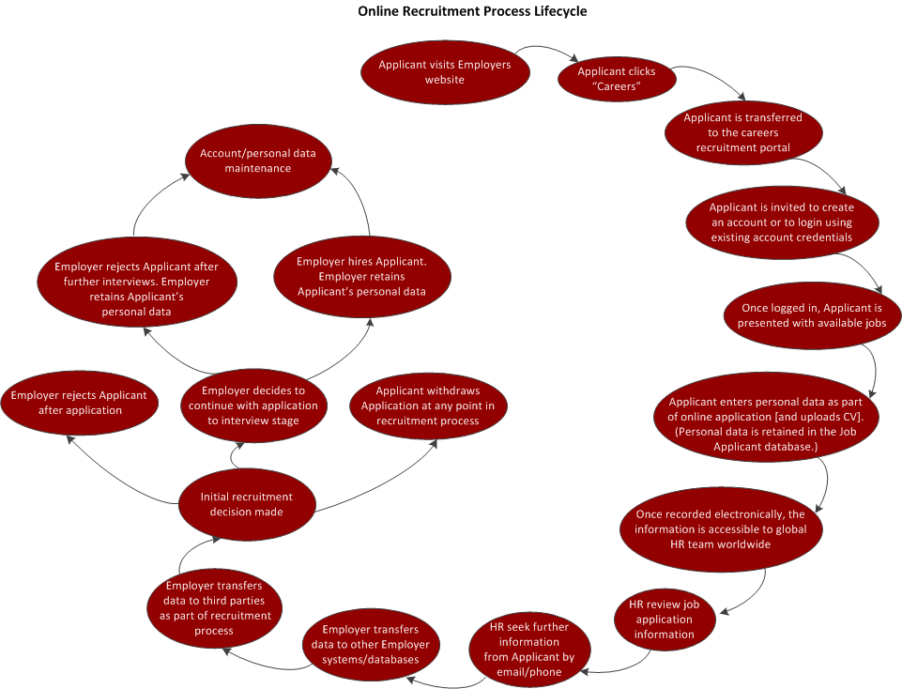
On-line Recruitment Process

Slide 5
The Debate
Is the use of IT in the role of HR a good thing?
What are the top five benefits?
What are the top five negative effects?
What can HR do to minimise the negative?
What do we see as the next step in this developing relationship?

