Slide 1
Whistleblowing: The Path to a Culture of Denunciation or a Blessing for Compliance?
XBHR Annual Conference
London
5-7 March 2014
Gerlind Wisskirchen, CMS Hasche Sigle
Gunda Niehaus, Procter and Gamble
David W. Garland, Epstein Becker & Green

Slide 2
Discussion Points
Reputation of whistleblowers
Statistics about whistleblowing
Protection and bounty laws and their extraterritorial application
Introducing whistleblower hotlines
Interviewing the whistleblower
The future of whistleblowing

Slide 3
Origin of “Whistle-blower”
Derives from the practice of English bobbies who would blow their whistle when they noticed the commission of a crime. The blowing of the whistle would alert both law enforcement officers and the general public of danger.

Slide 4
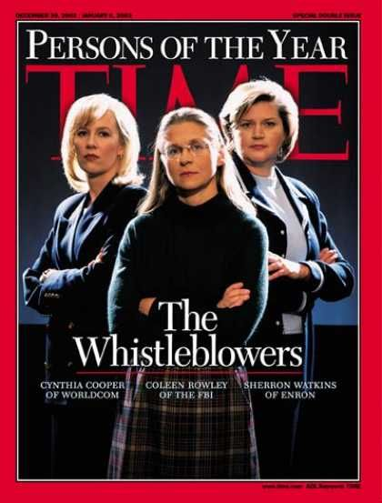
What Time Said About Them
“These women were for the 12 months just ending what New York City fire fighters were in 2001: heroes at the scene, anointed by circumstance. They were people who did right just by doing their jobs rightly – which means ferociously, with eyes open and with the bravery the rest of us always hope we have and may never know if we do.”
“Democratic capitalism requires that people trust in the integrity of public and private institutions alike. As whistle-blowers, these three became fail-safe systems that did not fail.”
“Almost all say they would not do it again. If they aren’t fired, they’re cornered: isolated and made irrelevant. Eventually many suffer from alcoholism and or depression.”

Slide 5
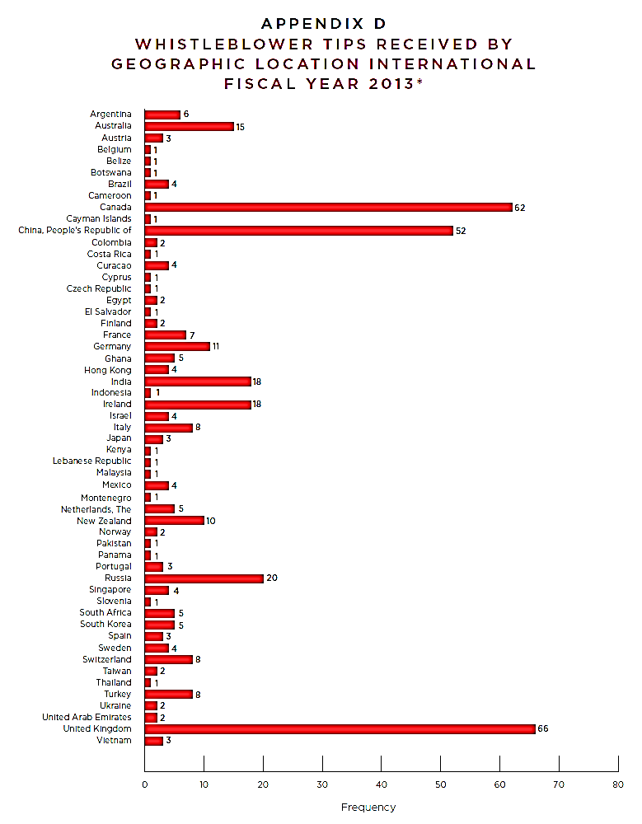
Whistleblower Tips in the U.S.
FY 2011 | FY 2012 | FY 2013
334 | 3,001 | 3,238

Slide 6
Trigger for Cross-Border Investigations
77% - internal leads
45% = whistleblower hotline
32% = employee outside the hotline
11% = internal audit finding
Other
Lead provided by third party other than regulatory authority
Notification by regulator or law enforcement
Findings arising from compliance due diligence

Slide 7
Most Common Subjects of Cross-Border Investigations
Bribery and corruption/FCPA
Embezzlement or misappropriation
Conflict of interest
Fraudulent financial reporting
Data breach
Industry-specific regulatory issue
(KPMG Survey on Cross-Border Investigations 2013)

Slide 8
The U.S. Legislative Response Since 2002
Sarbanes-Oxley Act
Dodd-Frank
Patient Protection and Affordable Care Act
American Recovery and Reinvestment Act
Consumer Product Safety Improvement Act
Contractor Employees of the Armed Forces
Food Safety Modernization Act
Tax Relief and Health Care Act
National Transit Systems Security Act of 2007
Whistleblower Protection Act
Moving Ahead for Progress in the 21st Century Act
National Defense Authorization Act of 2013

Slide 9
Bounty for Whistleblower
Amount equal to 10 to 30% of the monetary sanctions collected
Office paid whistleblowers over $14.8 million in 2013
One whistleblower awarded over $14 million for information that led to SEC enforcement action

Slide 10
Extraterritorial Application of Whistleblower Laws
Decisions of courts and ARB on extraterritoriality:
Asadi v. GE Energy (5th Cir.)
Carnero v. Boston Scientific Crop. (1st Cir. 2006)
Villanueva v. Core Laboratories (ARB 2012)
Liu v. Siemens AG (S.D.N.Y. Nov. 2013)
But see: O’Mahoney v. Accenture Ltd. (S.D.N.Y. 2008)
Effect of choice-of-law and forum clauses:
Martinez v. Bloomberg LP, 2014 U.S. App. LEXIS 686 (2d Cir. Jan. 14, 2014)
Atlantic Marine v. U.S. Dist. Ct. (U.S. Dec. 2013)

Slide 11
Implementing Whistleblower Hotlines in the EU
SOX Section 301: Public companies must create mechanisms for handling employees’ anonymous complaints of financial concerns
But: EU limitations:
Whistleblower system must be designed for exceptional cases
Whistleblower channel on constant anonymous basis not compatible with principle of fair data processing
Confidentiality/security of processing operations must be ensured
Aims of whistleblower channel must be included in code of conduct
Employees must be included about means of whistleblower channel

Slide 12
Implementing Whistleblower Hotlines/Channels
(EU-Wide Principles)
 | France | Germany/UK
Restrictions on subject matter of complaints | Only serious risks to company (relating to accounting, financial auditing, bribery, etc.) | No
Anonymous reporting | Anonymous reporting must be discouraged | Yes, provided that use is proportional
Restrictions applying to addressee of complaint | Subject to data protection regulations | Subject to data protection regulations
Accused's right to be informed about whistleblowing report | Yes | In general/Yes
Restrictions on retaining information related to complaint | Data must generally be deleted within 2 months/after end of disciplinary measures | Retention of data must be proportional to purpose
Prior consultation with representative body on implementation | Yes | Yes/No

Slide 13
Interviewing the Whistleblower
Who conducts the interview? Role of local and US counsel, and HR
Attorney as interviewer: ethical issues overseas?
Right to retained counsel?
Other employee representatives?
Hindrance on discipline?
Cultural differences, litigation-style questioning
Interpreters, cultural liaisons
Sharing results with whistleblower, attorney, or representative?

Slide 14
The Future of Whistle-Blowing in the US
More SEC awards to whistle-blowers
More SEC activity against companies who retaliate against whistle-blowers
More False Claims Act cases
More litigation over whistle-blower statutes
More efforts by companies to encourage internal reporting

Slide 15
Questions for Discussion
How do global companies encourage compliance in view of differences in cultures/legal environment?
Why do we see much less of an emphasis on whistle-blowing in Europe than in the US?

Slide 16
Back-up Slides

Slide 17
Do you regard Edward Snowden, the national security consultant who released information to the media about the phone scanning program, as more of a traitor, or more of a whistle-blower?
AUGUST 1, 2013
TRAITOR | 34%
WHISTLE-BLOWER | 55%
DK/NA | 11%
Regardless of whether or not he should be charged with a crime, do you think Snowden did the right thing or the wrong thing by disclosing the NSA intelligence-gathering efforts?
November 17, 2013
Right Thing | 37%
Wrong Thing | 55%
No Opinion | 8%
Quinnipiac University National Poll
ABC News/Washington Post Poll

Slide 18
New York Times:
“Edward Snowden, Whistle-Blower”
“It is time for the United States to offer Mr. Snowden … [a] substantially reduced punishment in light of his role as a whistle-blower, and have the hope of a life advocating for greater privacy and far stronger oversight of the runaway intelligence community.”
“… Mr. Snowden was clearly justified in believing that the only way to blow the whistle on this kind of intelligence-gathering was to expose it to the public and the resulting furor do the work his superiors would not.”
Editorial, 1 January 2014

